Slide 1


INSTITUTE: CHANDIGARH UNIVERSITY
DEPARTMENT: UIC
MCA
SOFTWARE TESTING
24CAH-654
DISCOVER . LEARN . EMPOWER

Slide 2
SOFTWARE TESTING
Unit -3
Test Management using JIRA

Slide 3
Difference between Defect and Bug
Defect:
Definition:
A defect is a broader term that encompasses any deviation from the expected behavior in software. It can include issues related to requirements, design, documentation, and functionality.
Scope:
Defects can be non-functional as well, encompassing issues related to performance, security, usability, and other aspects beyond just coding errors.
Lifecycle Stage:
Defects can be identified at any stage of the software development life cycle, from requirements gathering and design to coding and testing.
Origin:
Defects can originate from various sources, including misunderstandings in requirements, design flaws, coding mistakes, and issues introduced during testing.

Slide 4
Bug:
Definition:
A bug is a specific type of defect, often associated with coding errors or mistakes in the implementation of the software.
Scope:
Bugs typically refer to issues related to the coding or programming phase and are specifically concerned with deviations from the intended functionality.
Lifecycle Stage:
Bugs are typically identified during the testing phase or when the software is in use, highlighting issues with the code implementation.
Origin:
Bugs are often the result of coding errors, syntax mistakes, logical flaws, or other issues introduced during the coding phase of development.

Slide 5
BUG | DEFECT
A bug is a deviation from the customer’s requirement. | The functionality of an application not working as per the customer’s requirement is known as a defect.
The bug was found by the testing team. | The defect was found by the development team.
Reason Behind Bug: Missing Coding Wrong Coding Extra Coding | Reason Behind Defect: Giving wrong input may lead to a defect. Any code error may lead to a defect.

Slide 6
Defect Life Cycle
The Defect Life Cycle, also known as the Bug Life Cycle, is a series of stages that a software defect goes through from its identification to its resolution. The life cycle provides a structured approach for managing defects and ensures that they are addressed systematically. While the specific stages can vary between organizations, the typical Defect Life Cycle includes the following stages:
New:
Description: The defect is reported or identified for the first time.
Status: The initial status of the defect is "New."
Assigned:
Description: The defect is assigned to a developer or a team responsible for fixing it.
Status: The status is changed to "Assigned."

Slide 7
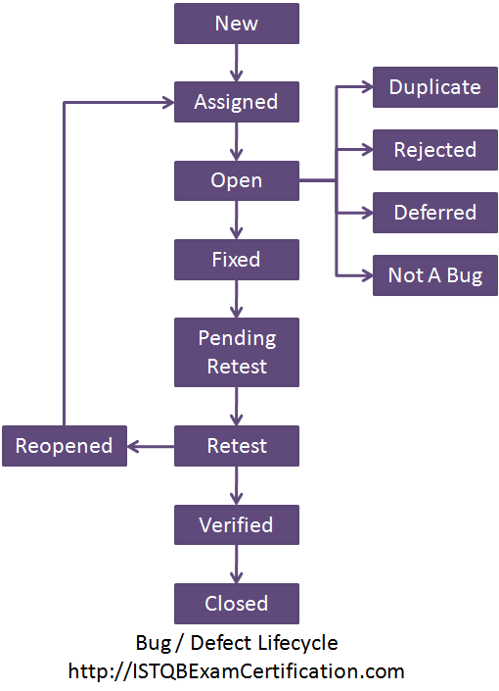

Slide 8
Open:
Description: The development team reviews the defect, confirms it, and begins the process of fixing it.
Status: The defect is marked as "Open."
Fixed:
Description: The developer has fixed the defect in the code.
Status: The defect status is changed to "Fixed."
Verified:
Description: The testing team verifies that the defect has been successfully fixed and is no longer present in the software.
Status: The defect is marked as "Verified."
Reopened:
Description: If the testing team finds that the defect still exists or if the fix has introduced new issues, the defect is reopened.
Status: The status is changed back to "Open" or "Reopened."
Closed:
Description: Once the fix has been verified and the defect is confirmed as resolved, it is marked as "Closed."
Status: The final status of the defect is "Closed."

Slide 9
THANK YOU

